Slide 1






JIRA
Copyright © 2017 Tech Mahindra. All rights reserved.
1

Slide 2



TABLE OF CONTENT
1. Introduction to JIRA and its features
2. Benefits
3. Jira Hierarchy
4. Issues and Workflows
5. Users and Permission
6. Scrum: Backlog, Sprint, Transitions
7. Burndown Chart
8. JIRA External Integration

Slide 3


Jira- Overview
What is JIRA? In simple terms: “JIRA is a web based issue tracker”. Jira software unlocks the power of agile by giving this tools to easily create and estimate stories, build the sprint backlog, identify team commitments and velocity, visualize team activities and report on the team progress.
Is it web based? Yes
Is it open source? No
Whose product is JIRA? www.atlassian.com

Slide 4
Features
Features
Because you've got issues
JIRA lets you priorities, assign, track, report and audit your 'issues,' whatever they may be — from software bugs and help-desk tickets to project tasks and change requests.
Reporting and statistics
Customizable reporting allows you to monitor the progress of your issues with detailed graphs and charts.
Workflow your way
Map your business process with a custom workflow.
An extensible platform
Integrate JIRA into your systems with our open API and 100+ free plugins.

Slide 5
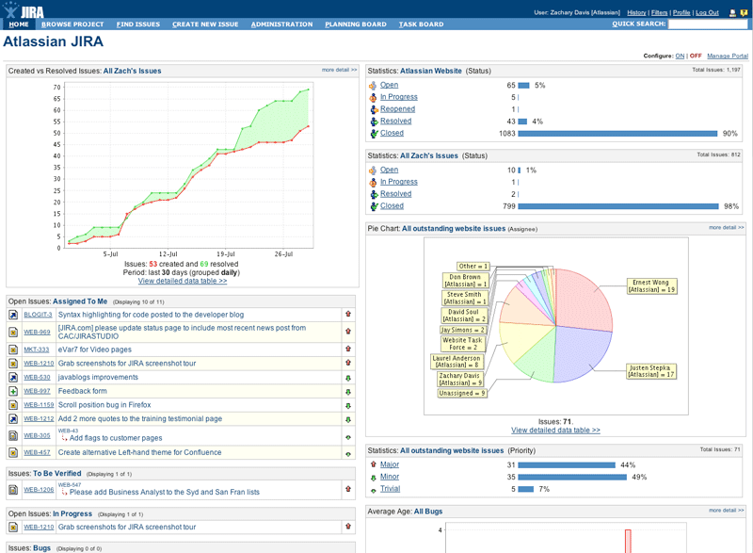

Jira - Benefits
Lightweight
Customisable
Source Access
Flexible

Slide 6

Jira Hierarchy

Slide 7
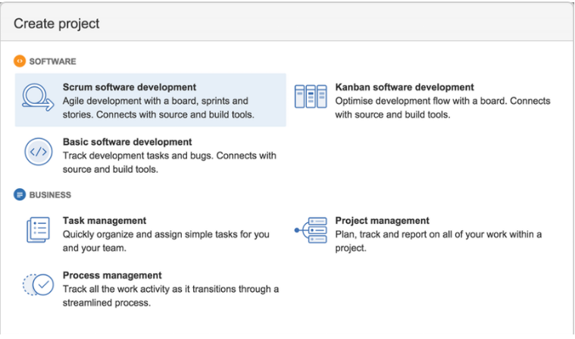
Projects
We can create different types of projects.

Slide 8

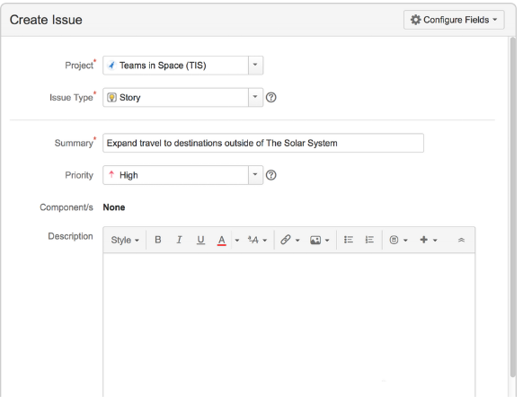
Jira - Issues
Any task that requires an action from a person is called issue.

Slide 9

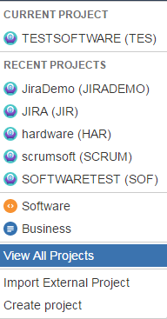
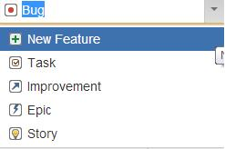
Jira – Project view and issue types
Projects
Issue Types

Slide 10


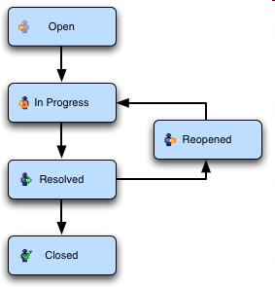
Jira - Workflows
A workflow is a set of statuses and transitions that an issue goes through during its lifecycle.

Slide 11


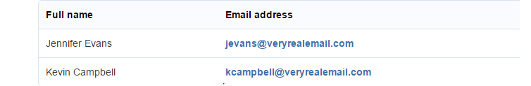
Jira – Create User
Add Users:
A software team without any members just won't cut it! Let's go ahead and configure Teams in Space's development team.
Settings > User Management
Select Users.
In the create user page provide the Name and Email Address of your team.

Slide 12

Jira - Permissions
Permissions are settings within JIRA applications that control what users within those applications can see and do.
Types of permissions:
1. Global permissions
2. Project permissions
3. Issue security permissions

Slide 13

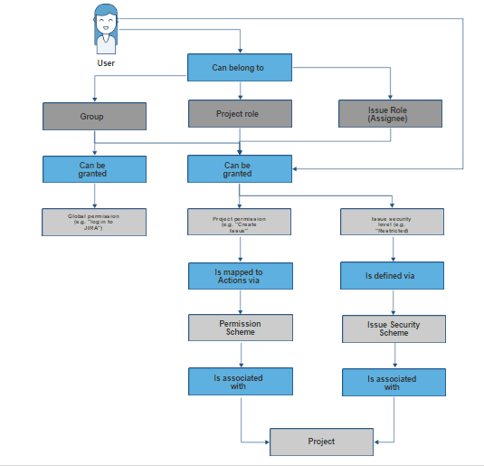
Jira – Permission Assignment

Slide 14

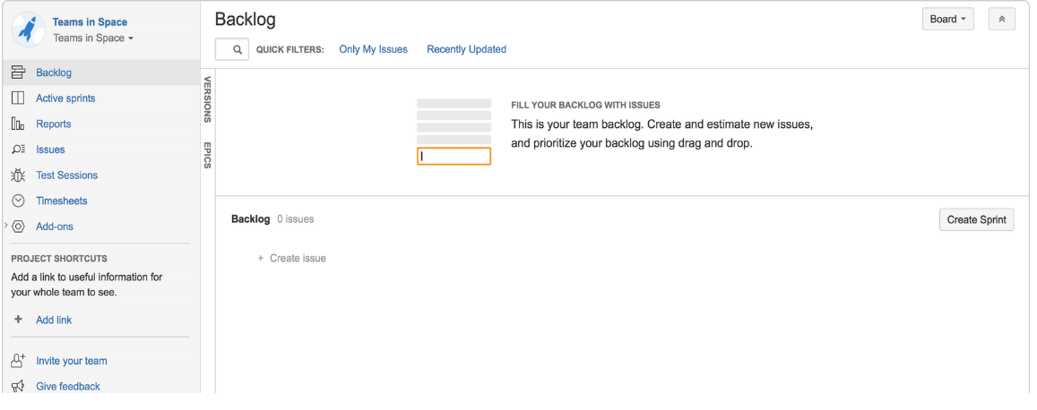
Jira – Scrum Board
A Scrum board is automatically created with your new project. Use your Scrum board to view and work on issues, such as new features or bugs. You can rank, view, edit, and track issues on your scrum board via the Backlog, Active sprints, and Reports.

Slide 15

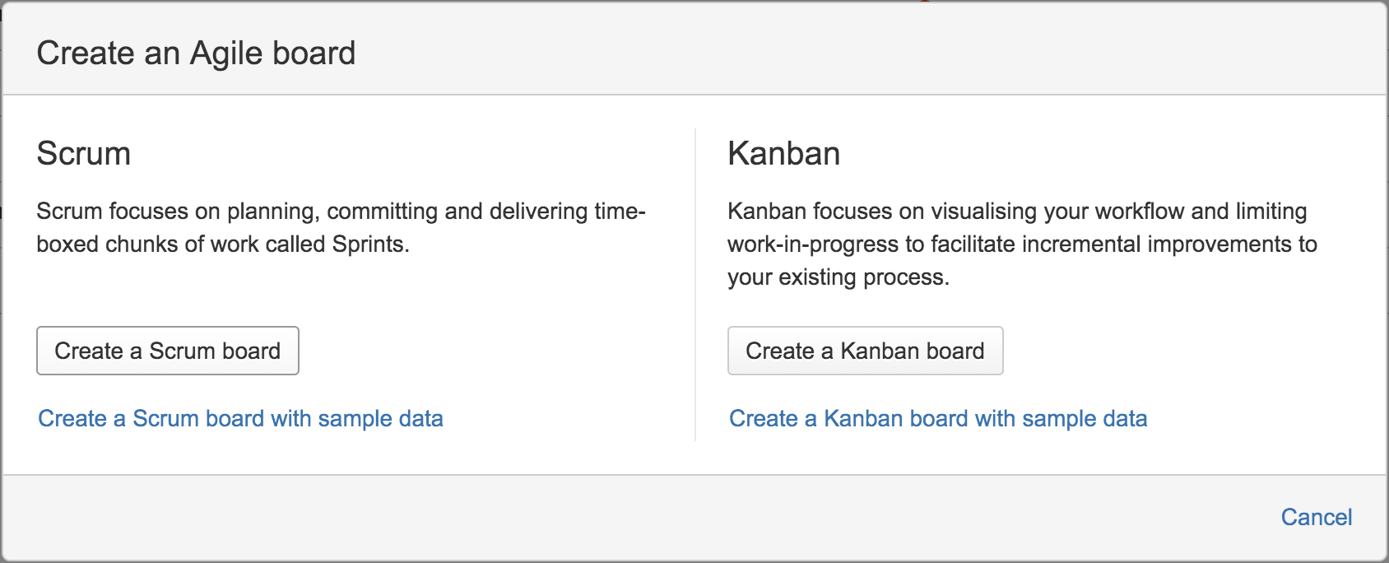
Jira – Scrum
Creating a new Scrum board

Slide 16

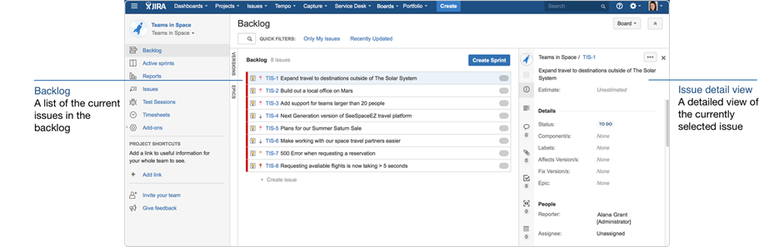
Jira - Backlog
The Backlog provides a place to organize your Sprints. We can create new issues or sub tasks, organize backlogs, create versions, organize via epics and start Sprints.

Slide 17
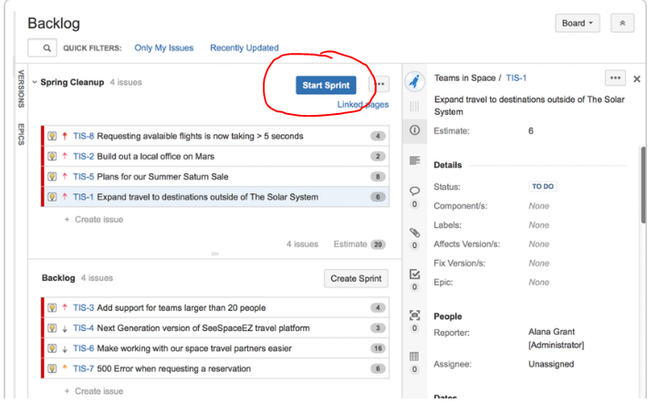
Jira – Sprint Planning
By clicking on Start Sprint, we are starting the Sprint.

Slide 18

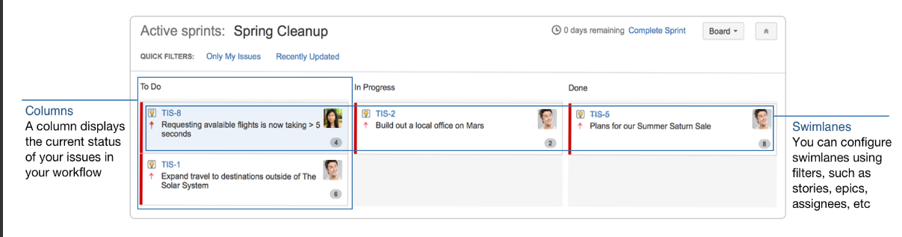
Jira - Active Sprints
The Active sprints page is where you monitor the progress of your team's work during a sprint.

Slide 19
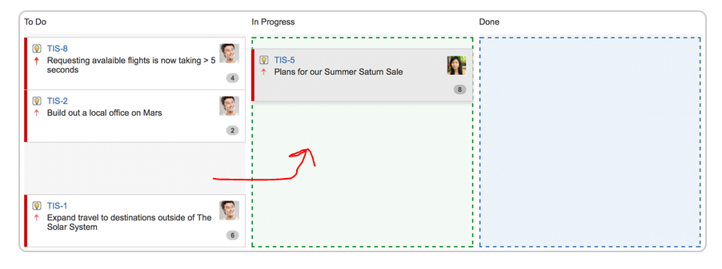
Jira - Transition Issues

Slide 20
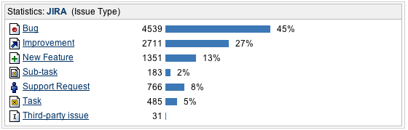
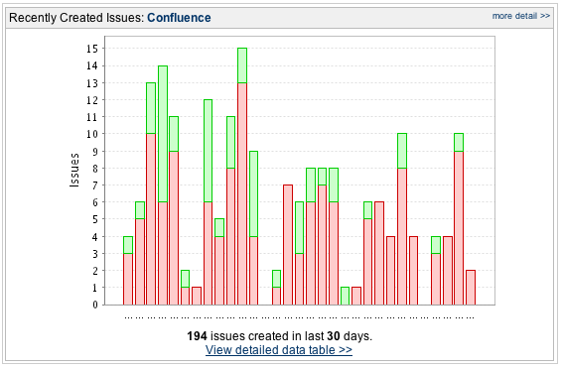
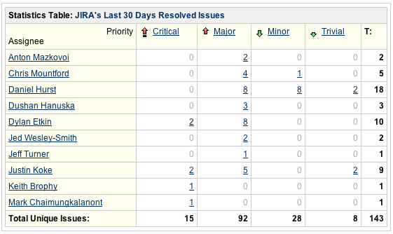
Jira - Sample Report

Slide 21
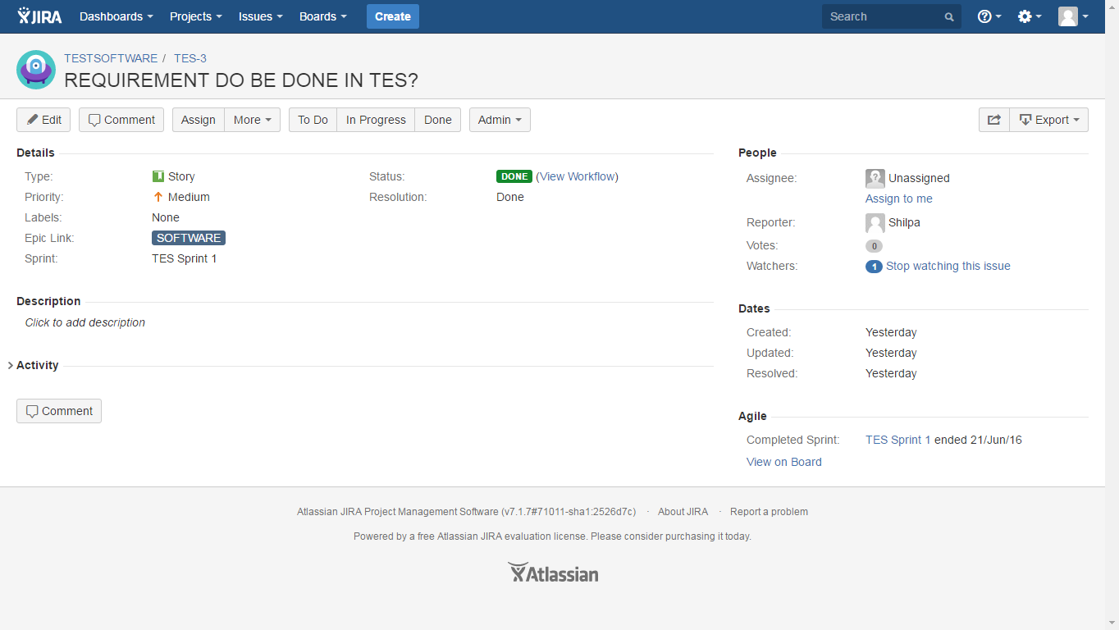

Slide 22
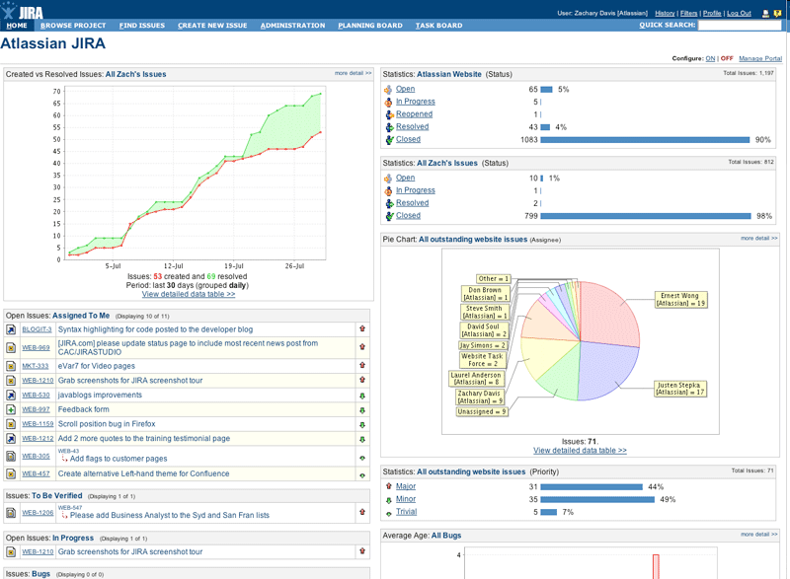
Jira – Sample Dashboard

Slide 23

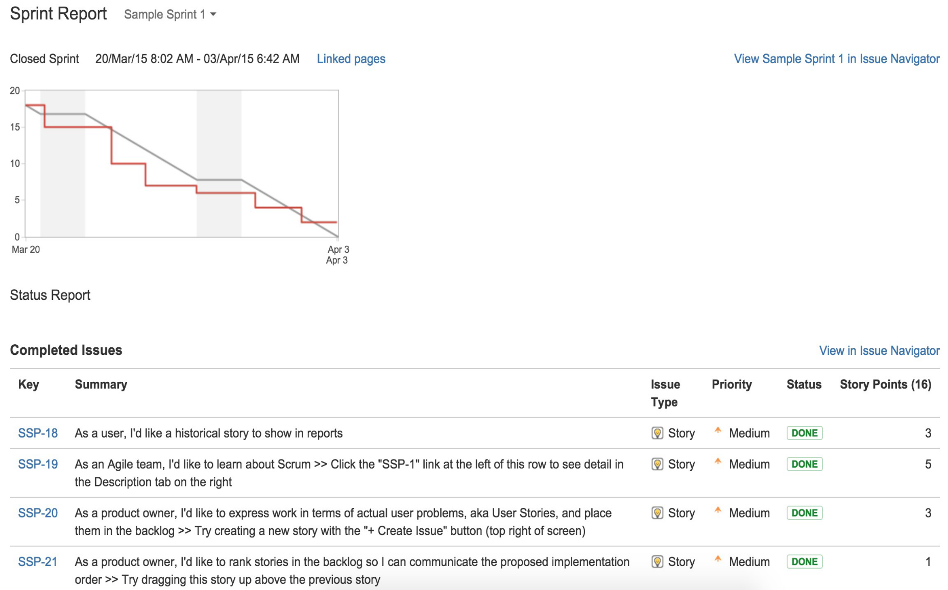
Jira - Sprint Report

Slide 24

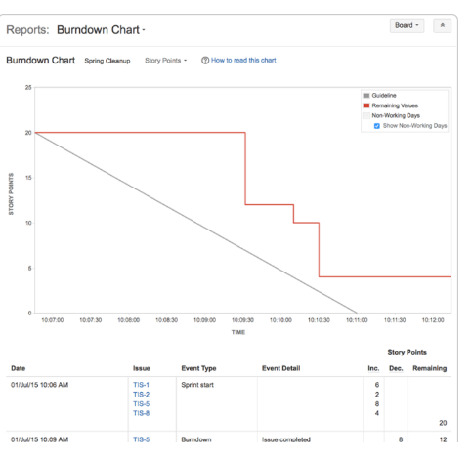
Jira - Burn-down Chart
The Burndown Chart is another useful tracking tool, which can help you visualize your team's progress, as well as determine whether your team is on target to achieve the sprint goal.

Slide 25

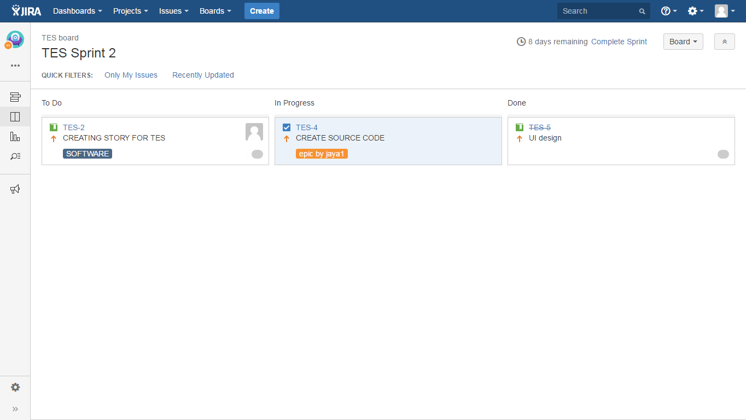
Jenkins - Sample Agile Board

Slide 26

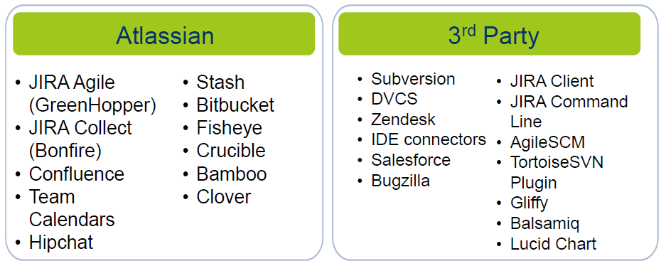
Jira - JIRA External Integration
Connecting JIRA Software to compatible development tools provides your team with a range of functionality and information related to your development work.
Configuring a cross-application link
Choose Projects.
Select the project that contains the fields you need to configure.
On the JIRA project configuration page, go to the Fields section.
On each field where you will create links, click the Renders link.
From the Active Renderer drop-down, select Wiki Style Renderer.

Slide 27
Thank You
Disclaimer
Tech Mahindra, herein referred to as TechM provide a wide array of presentations and reports, with the contributions of various professionals. These presentations and reports are for informational purposes and private circulation only and do not constitute an offer to buy or sell any securities mentioned therein. They do not purport to be a complete description of the markets conditions or developments referred to in the material. While utmost care has been taken in preparing the above, we claim no responsibility for their accuracy. We shall not be liable for any direct or indirect losses arising from the use thereof and the viewers are requested to use the information contained herein at their own risk. These presentations and reports should not be reproduced, re-circulated, published in any media, website or otherwise, in any form or manner, in part or as a whole, without the express consent in writing of TechM or its subsidiaries. Any unauthorized use, disclosure or public dissemination of information contained herein is prohibited. Unless specifically noted, TechM is not responsible for the content of these presentations and/or the opinions of the presenters. Individual situations and local practices and standards may vary, so viewers and others utilizing information contained within a presentation are free to adopt differing standards and approaches as they see fit. You may not repackage or sell the presentation. Products and names mentioned in materials or presentations are the property of their respective owners and the mention of them does not constitute an endorsement by TechM. Information contained in a presentation hosted or promoted by TechM is provided “as is” without warranty of any kind, either expressed or implied, including any warranty of merchantability or fitness for a particular purpose. TechM assumes no liability or responsibility for the contents of a presentation or the opinions expressed by the presenters. All expressions of opinion are subject to change without notice.
Copyright © 2015 Tech Mahindra. All rights reserved.

